Slide 1
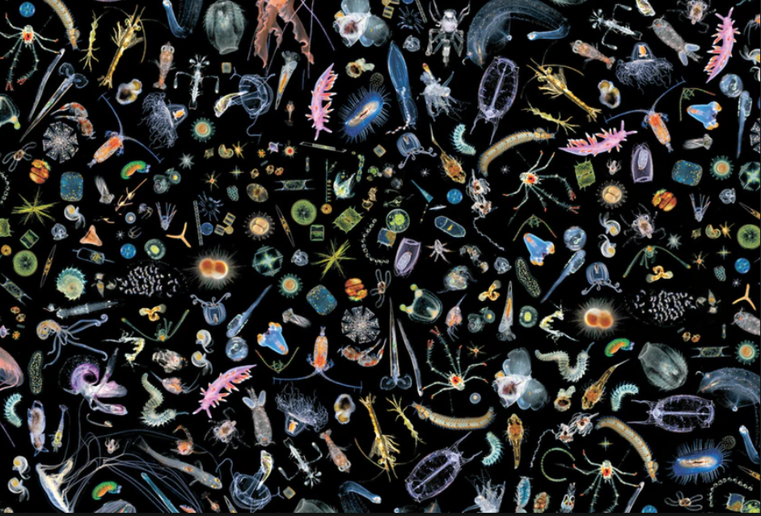
Coexistence In Size Spectrum Models
Richard Southwell
Gustav Delius
Richard Law

Slide 2


Slide 3
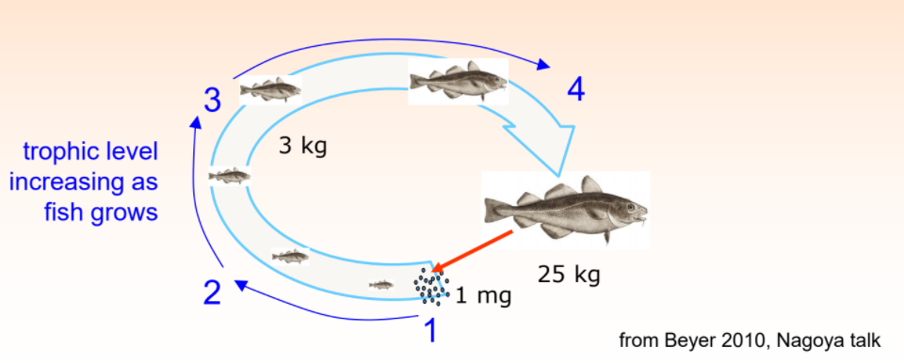

Slide 4
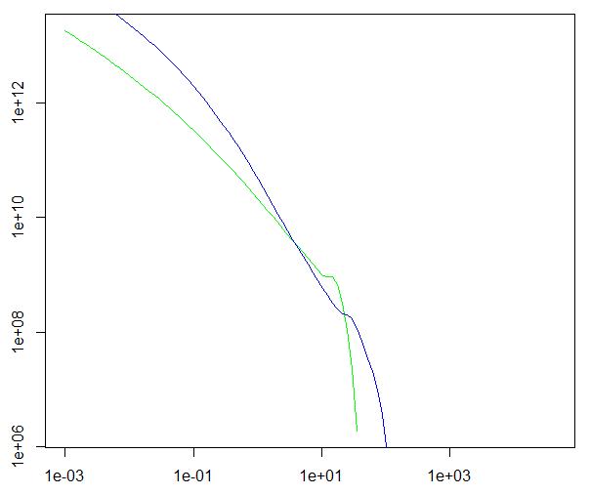


abundance
weight

Slide 5

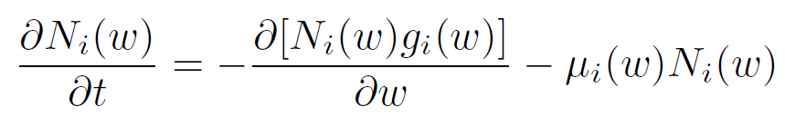

McKendrik-von Foerster equation

Slide 6
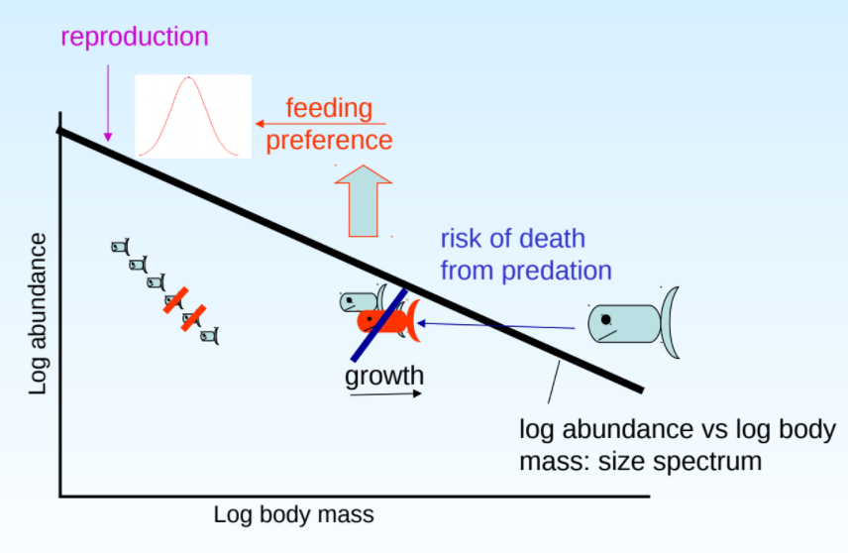

Slide 7
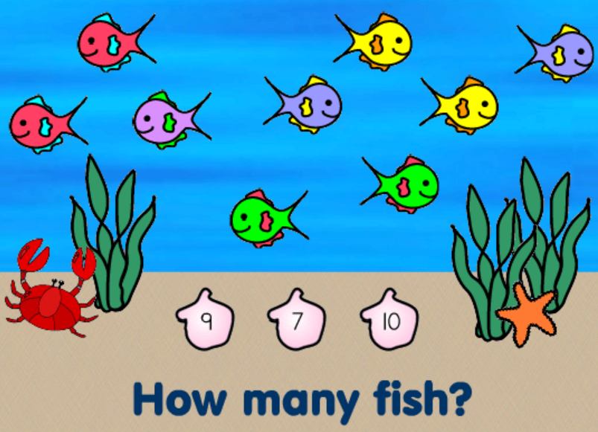



sum over prey
weight by preference
energy encountered
multiply by search rate of predator

Slide 8
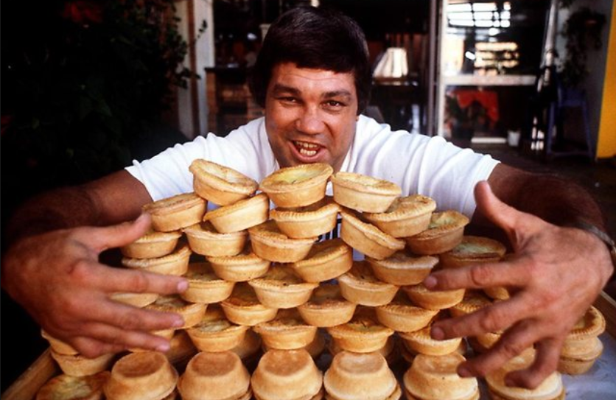
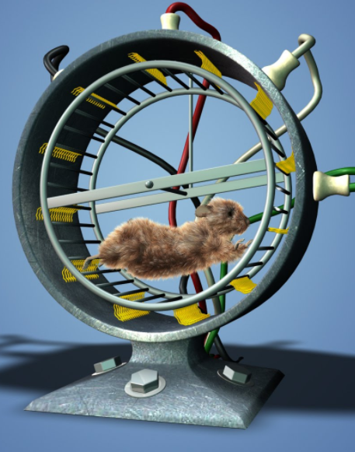


limited eating rate
energy costs for movement
and metabolism
energy for reproduction
growth

Slide 9
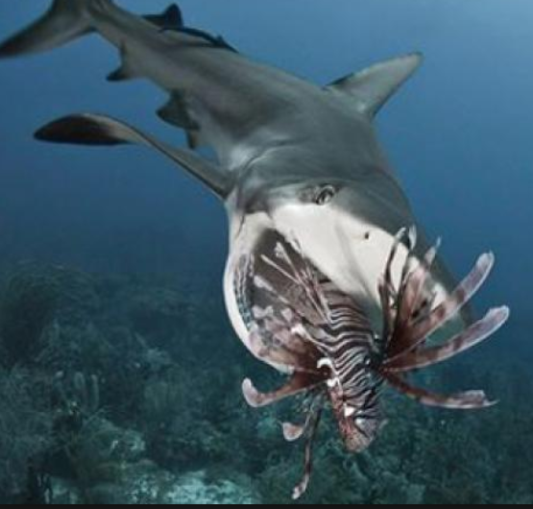


?

Slide 11

Abundance at egg size
Number of recruits
Growth rate of eggs

Slide 12
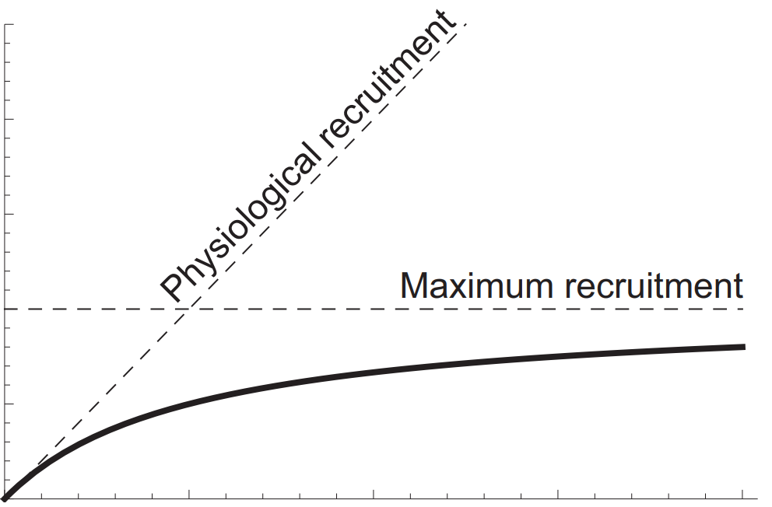
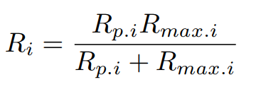
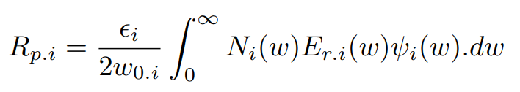
Recruitment
Egg production

Slide 13
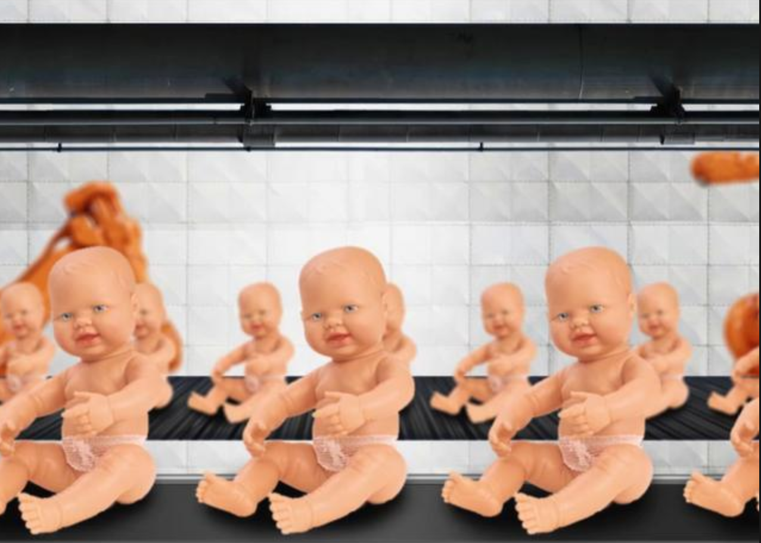

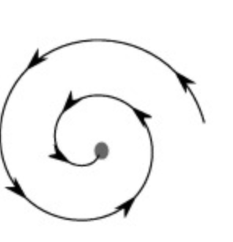


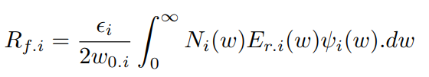
Hold recruitment fixed at
Evolve system to steady state
Choose reproduction efficiency
so

Slide 14
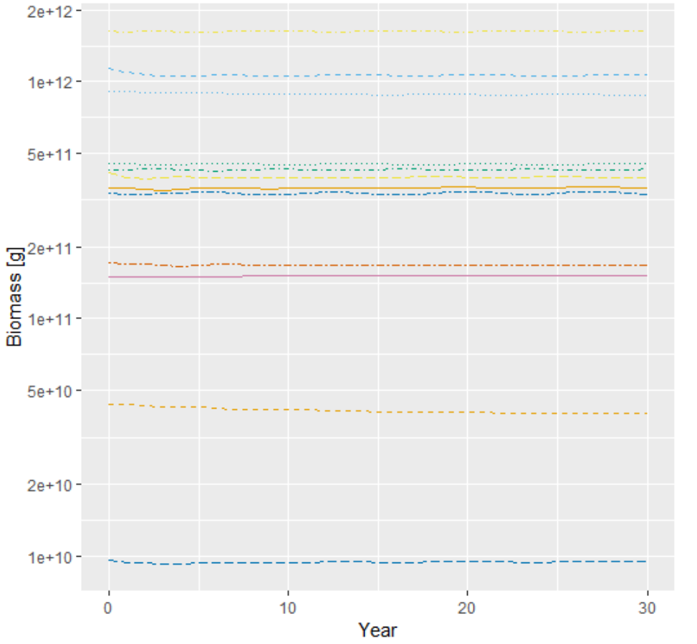
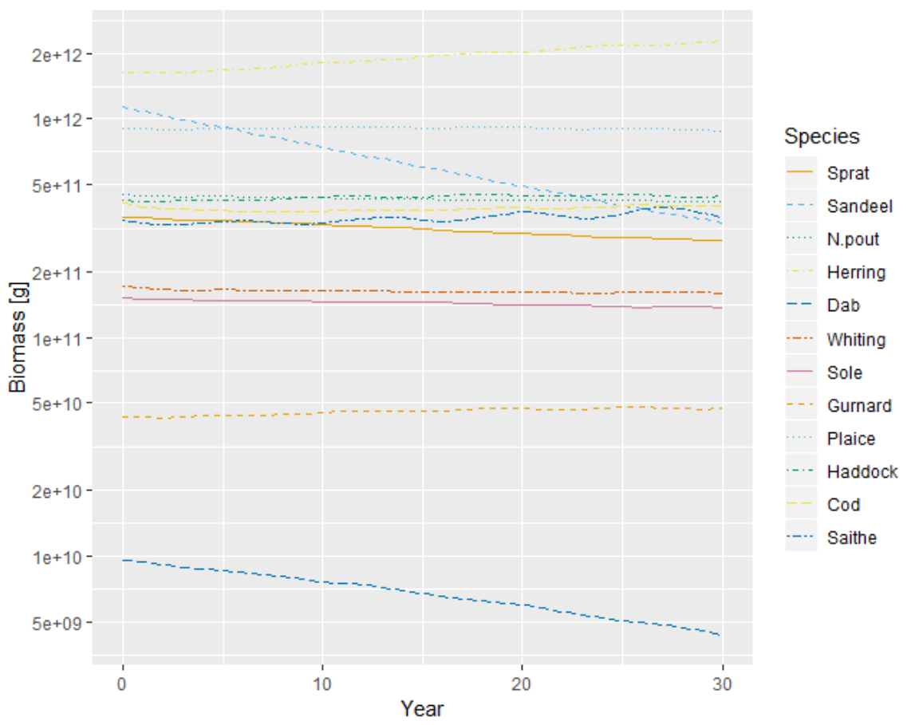
With SRR
Without SRR

Slide 15
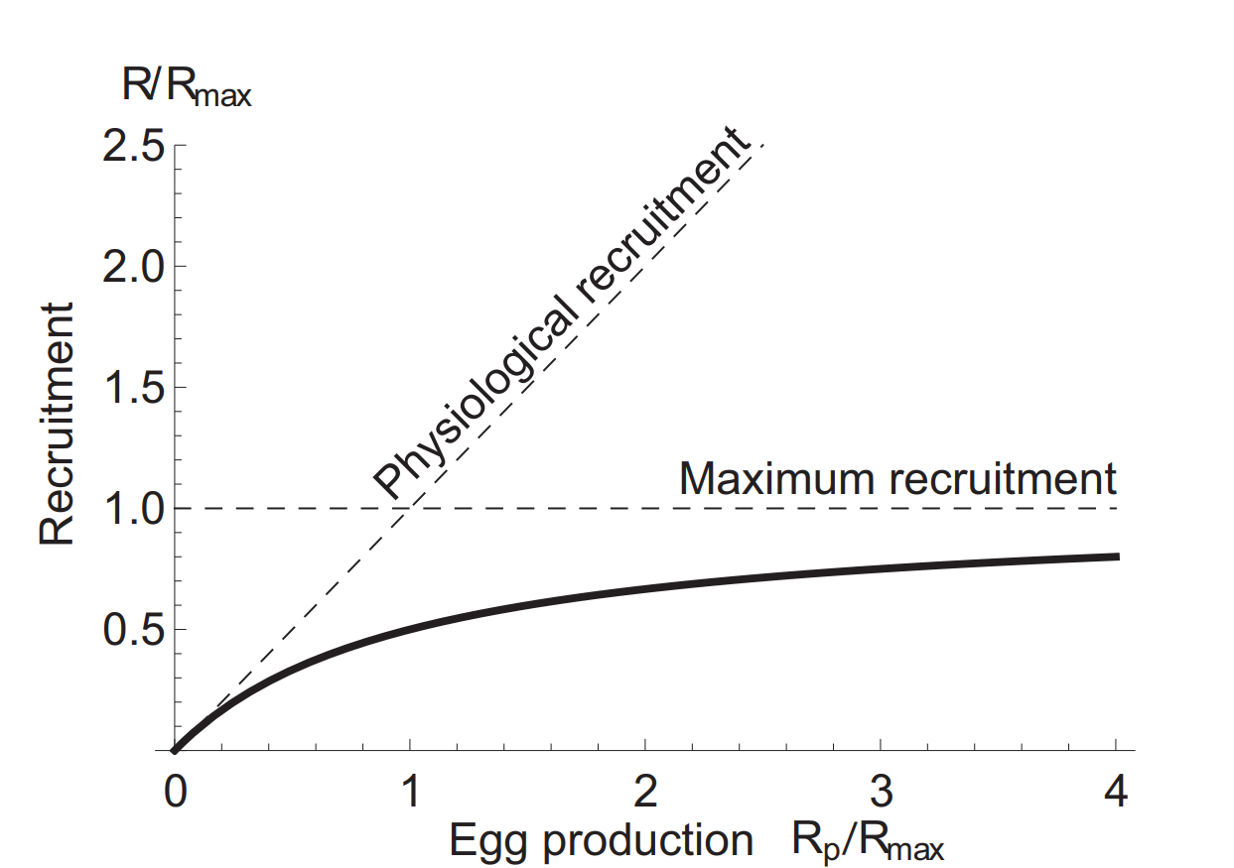

Slide 16
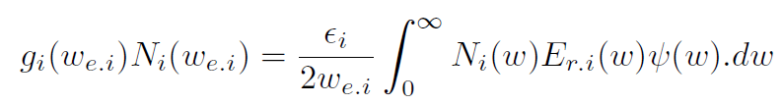

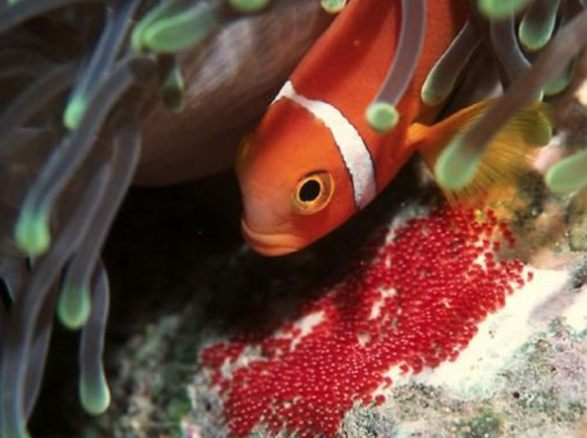

Slide 17
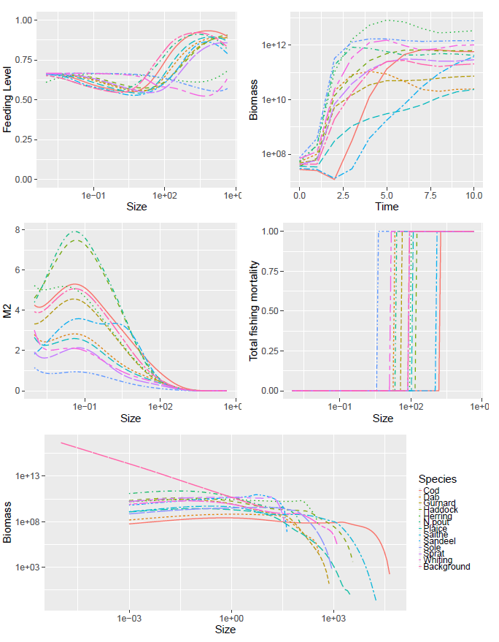

Slide 18


Slide 19
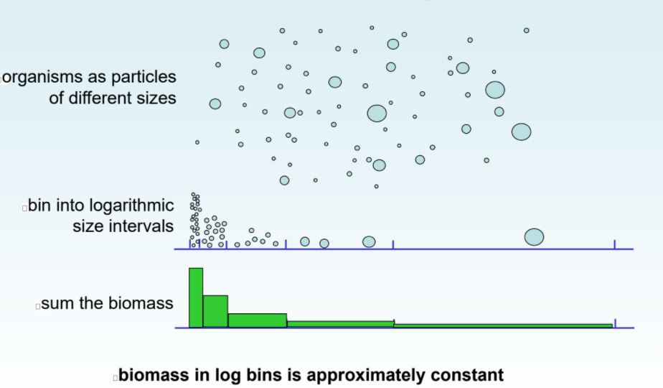
1
10
100
1000
Weight (g)
10000
100000

Slide 20
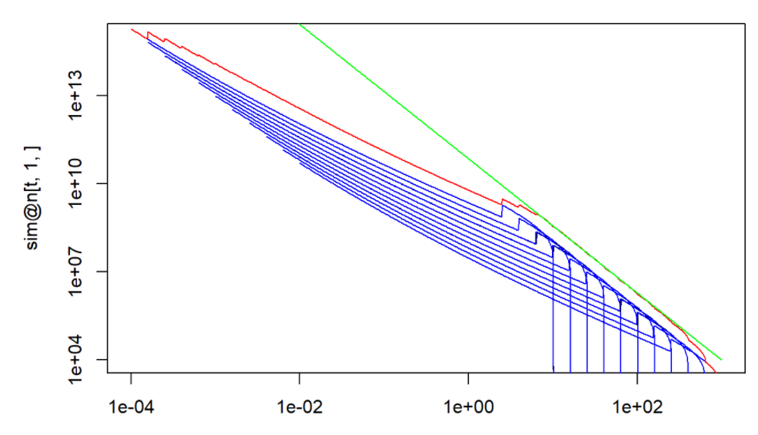
abundance
weight(g)

Slide 21


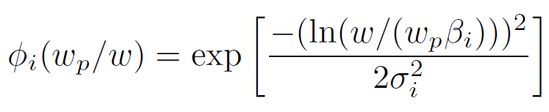

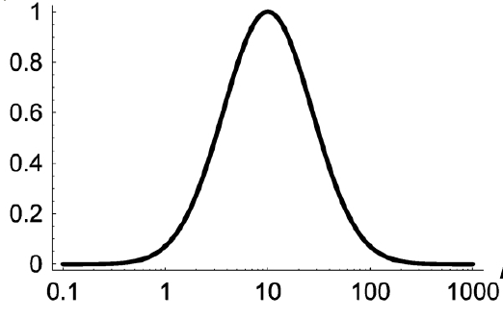








Slide 22



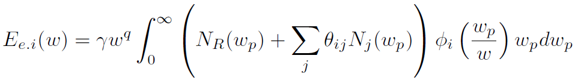


Slide 23
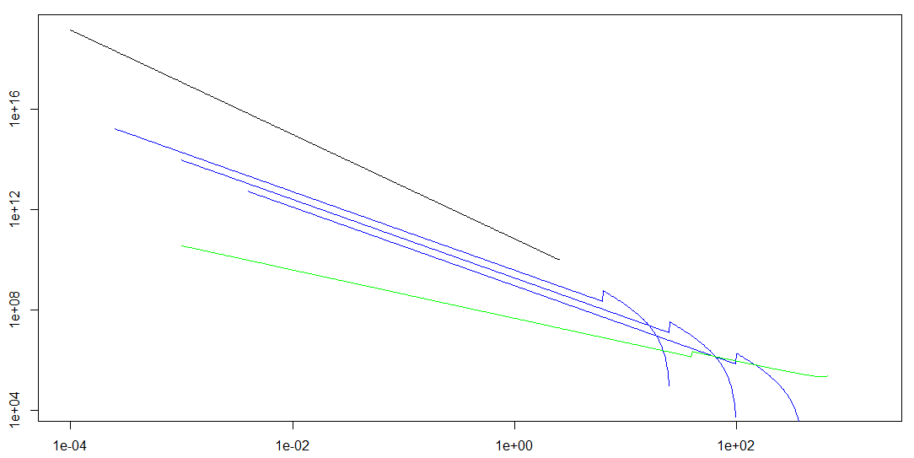

Slide 24
Size Spectrum Modelling
Gustav Delius, Richard Southwell

